Slide 1
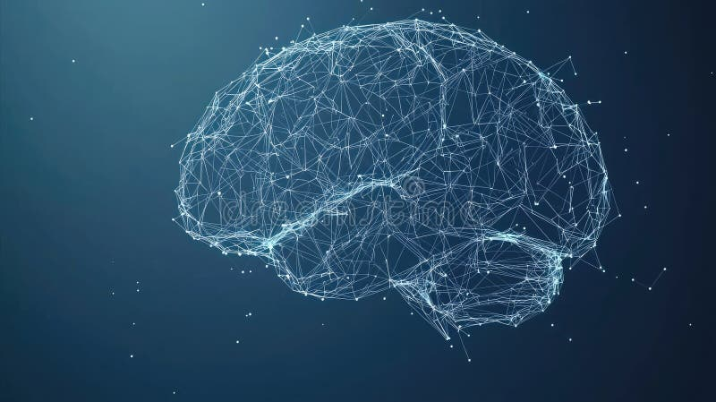
Knowledge Representation
Artificial General Intelligence & Cognitive and Conscious Systems
W14 · L25 & L26 · 2026

Slide 2
Contents
01
Introduction to Artificial General Intelligence
AGI · Knowledge Representation · Approaches · Challenges
02
Introduction to Cognitive and Conscious Systems
Cognitive Architectures · Consciousness Theories · Machine Consciousness
02

Slide 3
W14
Knowledge Representation
Exploring the foundations of intelligent systems

Slide 4
L25: Introduction to Artificial General Intelligence
Artificial General Intelligence (AGI) represents the pursuit of creating machines with human-like general intelligence.
AGI systems would possess the ability to:
• Learn across any domain without retraining
• Reason abstractly and solve novel problems
• Adapt to new environments autonomously
• Generalize knowledge from one task to another
Lecture Overview
Topics Covered:
• Definition and key concepts of AGI
• AGI vs. Narrow AI comparison
• Core capabilities required
• Three major paradigms
• Knowledge representation techniques
• Current research state
• Challenges and future roadmap
"AGI is the ability to achieve goals in a wide range of environments." — Legg & Hutter, 2007
04

Slide 5
What is AGI? — Definition and Key Concepts
AGI refers to machine intelligence that can understand, learn, and apply knowledge across diverse tasks at a level comparable to human intelligence.
Generalization
Autonomy
Adaptability
Reasoning
Transfer knowledge across domains
Operate without human intervention
Learn from new experiences
Logical inference and problem-solving
The term was popularized by Shane Legg and Marcus Hutter (2007): "the ability to achieve goals in a wide range of environments."
05

Slide 6
AGI vs Narrow AI — Understanding the Gap
Dimension | Narrow AI | Artificial General Intelligence
Scope | Single task or domain | Any task across all domains
Learning | Requires retraining for new tasks | Learns new tasks without retraining
Reasoning | Pattern matching and statistics | Abstract reasoning and causal understanding
Examples | ChatGPT, AlphaGo, DALL-E | Hypothetical — not yet achieved
Key Distinction: Narrow AI is trained for one task; AGI can generalize to novel tasks without retraining.
06

Slide 7
Core Capabilities Required for AGI
Abstract Reasoning
Causal Understanding
Common Sense
Drawing inferences and conclusions from limited or incomplete information
Comprehending cause-effect relationships beyond mere correlation
Understanding implicit everyday facts about how the world works
Transfer Learning
Metacognition
Social Intelligence
Applying knowledge and skills from one domain to novel, unrelated tasks
Awareness and control of one's own thinking processes and limitations
Understanding and effectively interacting with other intelligent agents
07

Slide 8
Approaches to AGI — Three Major Paradigms
Symbolic AI
Connectionist
Hybrid (Neuro-Symbolic)
GOFAI — Good Old-Fashioned AI
Neural Networks & Deep Learning
Best of Both Worlds
• Rule-based systems
• Logic programming
• Knowledge representation
• Expert systems
Strengths: Explicit reasoning
Weaknesses: Hard to learn
• Deep neural networks
• Emergent behavior
• Representation learning
• End-to-end training
Strengths: Pattern recognition
Weaknesses: Black box
• Neural + symbolic integration
• World models
• Causal reasoning
• Structured learning
Strengths: Reasoning + learning
Weaknesses: Complexity
08

Slide 9
Knowledge Representation for AGI
Knowledge Representation (KR) is foundational to AGI — it determines how machines store, organize, and reason about information.
A good KR system must satisfy four key criteria:
Four Major KR Models
Logic-Based Models
First-order logic, theorem proving
Semantic Networks
Graph-based concept relationships
1
Representational
Represent all knowledge
2
Inferential Adequacy
Derive new knowledge
Frame-Based Models
Structured templates with slots
Production Rules
If-then rules for reasoning
3
Inferential Efficiency
Enable quick reasoning
4
Acquisitional
Easy knowledge expansion
09

Slide 10
Semantic Networks and Frames
Semantic Networks
Frames
Graph-based with nodes (concepts) and edges (relationships).
Key: isA (taxonomy), hasPart (parts), can (capability)
Introduced by Marvin Minsky (1975). Structured templates with slots, fillers, and facets.
Slot | Value | Type
Make | Toyota | String
Model | Camry | String
Engine | V6 | String
Wheels | 4 | Integer
Animal
isA
Bird
isA
Penguin
can
Fly
Example: Frame "Car" with hierarchical inheritance
Applications: Expert systems, NLP, knowledge graphs, chatbots, and recommendation systems
10

Slide 11
Ontologies and Logic-Based Representation
Ontologies
Logic-Based Models
Production Rules
Formal conceptualizations:
• Classes — concepts
• Properties — attributes
• Relations — associations
• Axioms — rules
Tools: OWL, RDF, Protege
First-Order Predicate Logic:
• Formal languages
• Deductive reasoning
• Theorem proving
• Model generators
Strength: Strong inference
If-then rules for reasoning:
• IF condition
• THEN action
• Forward chaining
• Backward chaining
Foundation of:
Expert systems
Ontologies offer strong inference; Frames provide readability; Semantic networks excel at visualization
11

Slide 12
Current State of AGI Research
OpenAI GPT Series
DeepMind Gato
LLMs with emergent reasoning across diverse tasks
Single generalist agent for hundreds of tasks
Meta FAIR
Anthropic Claude
Open-source models and multimodal learning
Constitutional AI for safety and alignment
Assessment: Current systems demonstrate impressive capabilities but lack true generalization, causal reasoning, and common sense. The consensus: we are still far from achieving human-level AGI.
12

Slide 13
Challenges and Future Roadmap for AGI
Major Challenges
Future Directions
1
Alignment Problem — ensuring AGI goals match human values
Neuro-Symbolic Integration
Neural learning + symbolic reasoning
World Models
Internal representations of the world
Continual Learning
No catastrophic forgetting
Brain-Inspired Architectures
Insights from neuroscience
2
Common Sense Reasoning — encoding implicit knowledge
3
Causal Understanding — beyond correlation to causation
4
Computational Requirements — massive compute needs
5
Safety and Control — preventing unintended consequences
6
Evaluation Metrics — measuring general intelligence
13

Slide 14
L26
Cognitive and Conscious Systems
From intelligent machines to systems that think and perceive

Slide 15
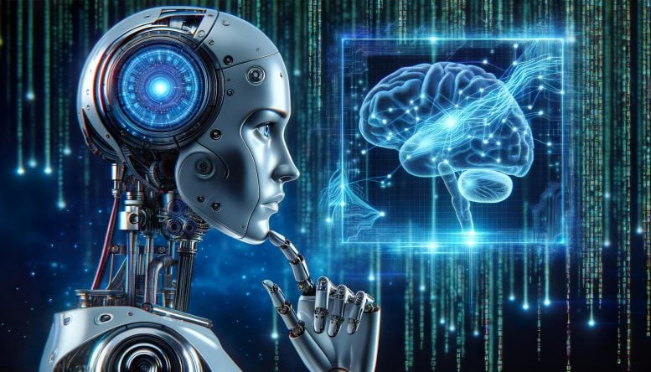
L26: Introduction to Cognitive and Conscious Systems
Cognitive systems are AI architectures inspired by human cognition.
This lecture explores:
• Cognitive Architectures — SOAR, ACT-R, LIDA
• Consciousness Theories — GWT, IIT, Predictive Processing
• Machine Consciousness — Can AI be conscious?
• Applications & Ethics — Impact and challenges
"The question of whether a machine can think is no more interesting than whether a submarine can swim."
— Edsger Dijkstra
15

Slide 16
What Are Cognitive Systems?
Cognitive systems are intelligent systems that emulate human cognitive processes: perception, attention, memory, learning, reasoning, decision-making, and language understanding.
Autonomy
Adaptability
Robustness
Real-Time
Multimodal
Operate without constant guidance
Learn from new experiences
Handle uncertainty and noisy data
Process and respond in real time
Combine multiple information sources
Key Distinction: Cognitive systems aim to replicate how humans think, not just match human performance.
16

Slide 17
Cognitive Architectures — Overview
A cognitive architecture is a blueprint for intelligent agents — specifying structures for perception, memory, learning, reasoning, planning, and action selection.
SOAR
ACT-R
LIDA
CLARION
State, Operator And Result
Universal problem-solving with production rules
Adaptive Control of Thought-Rational
Cognitive modeling with declarative memory
Learning Intelligent Distribution Agent
Based on Global Workspace Theory
Connectionist Learning with Adaptive Rule Induction
Dual-process cognition
These architectures provide unified frameworks for building general intelligent systems.
17

Slide 18
SOAR and ACT-R Architectures
SOAR (1987)
ACT-R (1990s)
Full Name: State, Operator And Result
Creators: Laird, Newell, Rosenbloom
Core: All cognition as search through problem spaces
Mechanisms:
• Production rules • Chunking
• Universal subgoaling
Apps: Military, game AI, robotics
Full Name: Adaptive Control of Thought-Rational
Creator: John R. Anderson
Core: Models cognition with neural plausibility
Modules:
• Declarative & procedural memory
• Goal, visual, manual modules
Apps: Psychology, HCI, education
Both aim for general intelligence through unified cognitive theories — SOAR emphasizes problem-solving; ACT-R emphasizes human-like cognition
18

Slide 19
Consciousness — Definition and the Hard Problem
Consciousness: the state of subjective experience — the "what it is like" to be aware (Nagel, 1974: "What Is It Like to Be a Bat?")
Access Consciousness
Phenomenal Consciousness
Information globally available — can be reported, remembered, and used for decisions
Subjective experience — qualia. The redness of red, the pain of a headache.
The Hard Problem (Chalmers, 1995)
Why does brain activity produce subjective experience? Easy Problems are tractable; the Hard Problem remains a mystery.
19

Slide 20
Global Workspace Theory (GWT)
By Bernard Baars (1988), GWT likens consciousness to a theater:
• Unconscious processes in background
• Content enters a "global workspace"
• Like a spotlight on stage
Mechanism: Info becomes conscious when globally broadcast.
GNW (Dehaene): Burst of neural activity; stimuli enter awareness when activity spreads (~300ms).
The Theater Model
GLOBAL WORKSPACE
Conscious content broadcast
Vision
Memory
Decision
Language
Motor
Emotion
Unconscious specialized processors
Implementation: LIDA by Stan Franklin simulates global workspace in artificial agents.
20

Slide 21
Integrated Information Theory (IIT)
Developed by Giulio Tononi (2004), IIT proposes consciousness = integrated information in a system.
Phi (Φ): Measures integration. Higher Φ = more consciousness. Φ = 0 means no consciousness.
IIT 4.0 (2023): Refined axioms into formal math framework.
Consciousness Spectrum (Φ)
Phenomenological Axioms
Intrinsic
Exists for itself
Composed
Has structure
Integrated
Experience is unified
Exclusive
Experience has borders
Controversy: 2023 adversarial collaboration pitted IIT vs GWT; critics question testability.
21

Slide 22
Predictive Processing and Consciousness
Predictive Coding (Friston, 2010; Clark, 2013):
The brain is a prediction machine — generating world models and minimizing prediction errors.
Hierarchical Inference:
• Higher levels predict lower inputs
• Mismatches generate errors
• Errors update beliefs
Key Insight: Perception is active construction.
Hierarchical Prediction
High-Level Predictions
Mid-Level Integration
Sensory Input + Errors
Prediction errors update beliefs
Anil Seth (2021) — Being You: Consciousness as "controlled hallucination" shaped by prediction. Our brains generate predicted worlds and refine them with sensory data.
22

Slide 23
Machine Consciousness — Can AI Be Conscious?
Arguments FOR
Arguments AGAINST
1. Functionalism
Consciousness is information processing, not substrate.
2. IIT Implication
High Φ systems possess consciousness.
3. GWT Implementation
Global Workspace can be computed (LIDA).
1. The Hard Problem
No theory bridges physical processes to experience.
2. Chinese Room
Syntax is not semantics (Searle).
3. Causal Structure
AI lacks biological complexity of brains.
Consensus: No current AI system is conscious. The question remains open and deeply debated.
23

Slide 24
Applications of Cognitive Systems
Healthcare
Autonomous Vehicles
Robotics
Diagnostics, treatment, mental health
Perception-decision pipelines
Human-robot interaction, adaptive manipulation
Education
NLP & Conversational AI
Decision Support
Intelligent tutoring, personalized learning paths
Conversational agents, semantic understanding
Complex problem-solving, strategic planning
Impact: Cognitive systems bridge the gap between narrow AI and human-like intelligence, enabling flexible and robust systems.
24

Slide 25
Future Directions in Cognitive AI
Neuro-Symbolic
Neural + symbolic reasoning
Brain-Computer Interfaces
Direct neural integration
Embodied Cognition
Intelligence from physical interaction
Developmental Robotics
Robots that learn like children
Whole-Brain Emulation
Simulating biological neural circuits
Continual Learning
No catastrophic forgetting
Vision: Moving from task-specific AI to systems that learn, adapt, and evolve like biological minds — achieving true cognitive flexibility and general intelligence.
25

Slide 26
Ethical Considerations and Societal Impact
AI Safety
Consciousness Rights
Job Displacement
Ensuring AGI acts in humanity's interest
Moral status of conscious machines
Economic impacts of intelligent systems
Bias and Fairness
Transparency
Governance
Preventing discriminatory outcomes
Explainability of complex decisions
Regulatory frameworks for AGI
The Dual-Use Dilemma: The same capabilities that could solve global challenges (disease, climate, poverty) could also pose existential risks if misaligned or misused.
26

Slide 27
Summary and Key Takeaways
L25: Artificial General Intelligence
L26: Cognitive & Conscious Systems
1. AGI aims for human-level general intelligence across all domains
2. Three paradigms: symbolic, connectionist, and hybrid
3. KR — semantic networks, frames, ontologies — is foundational
4. Challenges: common sense, causality, alignment, safety
1. Cognitive architectures (SOAR, ACT-R) model human-like intelligence
2. GWT, IIT, Predictive Processing — scientific frameworks
3. Machine consciousness — open question
4. Ethics paramount as capabilities advance
27

Slide 28
The Journey Continues
From representing knowledge to understanding minds — the quest for AGI challenges us to explore the nature of intelligence, cognition, and consciousness.
W14 · Knowledge Representation · 2026
AI Course

